Slide 1
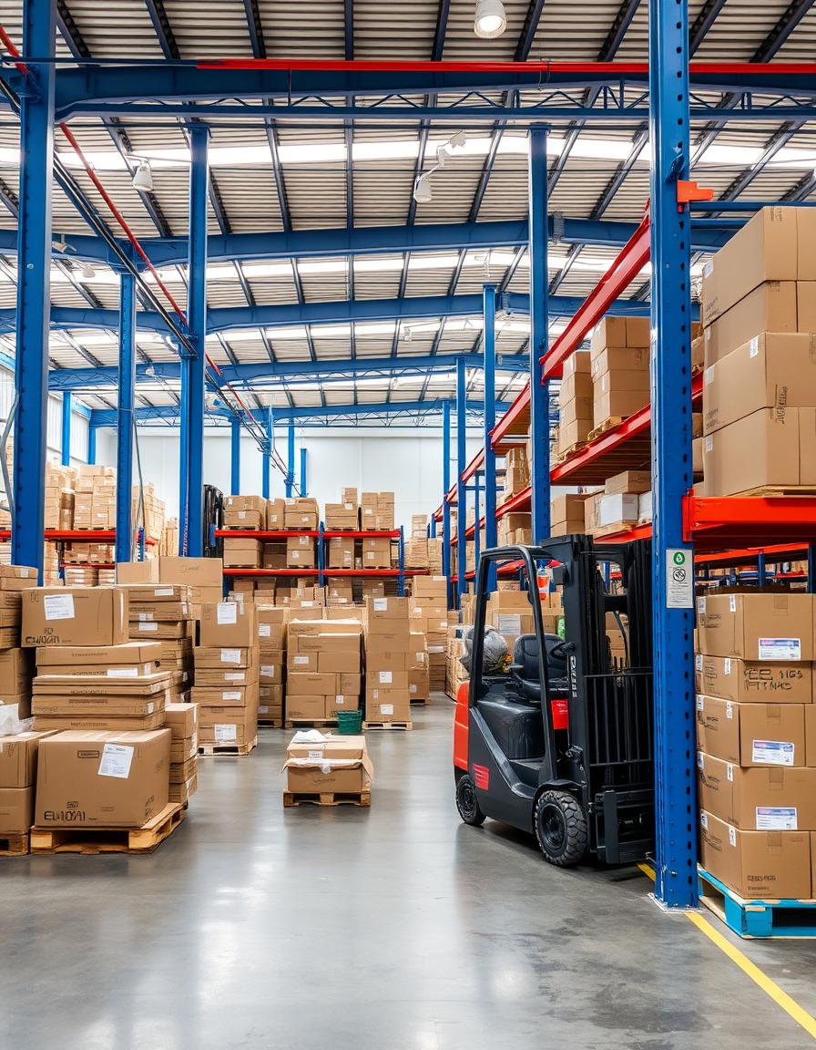

Supply Chain Performance Analysis
This project analyzes supply chain challenges in a retail company.
The focus is on cost, supplier defects, and inventory optimization.
Presented by: Mohamed Ayman
Instructor: Sherihan Ali
Company: EYOUTH
Date: 17/5/2024

Slide 2
Project Background and Business Problem
Industry Context
In the beauty and personal care industry, operational efficiency, quality consistency, and customer personalization are key drivers of competitive advantage. Rapid demand shifts, inventory imbalances, and unreliable supply chains pose significant challenges.
Business Problem
Despite strong sales in skincare and high engagement from key customer segments, the business faces:
•Supplier unreliability affecting product quality and timelines
•High defect and inspection failure rates in manufacturing
•Inventory mismatch leading to overstocking/stockouts
•Missed personalization opportunities in marketing
•Rising transportation costs, especially on key routes
These issues reduce efficiency, increase costs, and risk customer satisfaction
.

Slide 3

Project Objectives and Scope
Project Objectives:
To enhance operational performance and customer satisfaction by optimizing supplier selection, improving manufacturing quality, aligning inventory with demand trends, and reducing logistics costs through data-driven decision-making..
Project Scope
•Supplier Analysis: Evaluate supplier reliability, defect rates, and turnover efficiency
•Manufacturing Insights: Analyze defect rates, inspection failures, and production lead times across product categories
•Inventory Management: Assess stock levels, turnover rates, and demand-supply alignment
•Customer Analysis: Identify high-value segments and optimize personalization strategies
•Shipping & Transportation: Examine cost and delivery time by route and mode

Slide 4

Dataset and Data Preparation
1- Dataset Overview
Simulated data with 100 products,
including SKU, revenue, and supplier info.
2- Data Cleaning
Edited Table and coulmns names to make it concise and clear
Replacing Values: In Power Query, we replaced "Unknown" with "Prefer not to say.“ to make data more respectful and clearer
noticed two columns with the same name, "Lead Time.“we renamed one column to "Supplier Lead Time" and the other to "Shipping Lead Time.“
Standardized number formats and corrected data types.
Ensured clean and analysis-ready dataset.

Slide 5
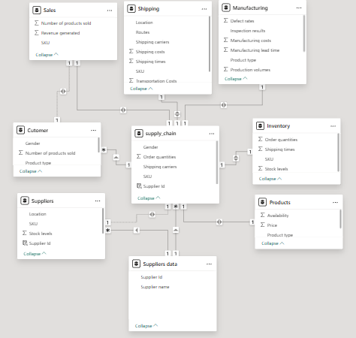
Dataset and Data Preparation
Data Modeling
Normalized the flat table into multiple logical tables :Product, Suppliers, Shipping, Sales, Manufacturing, Customer, and Inventory.
Defined clear relationships between tables using Primary and Foreign keys (e.g., SKU, Supplier ID).
Ensured referential integrity and removed redundancy.

Slide 6
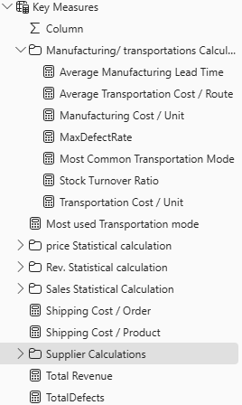
Key KPIs and Measures
Manufacturing/Transportations Measures:
Avg. MLT,
Avg. Trans.Cost,
MFG Cost/units,
Stock turnover ratio,
Trans. Cost,
Most CommonTrans. Mode,
max Defect rates by supplier.
Integrated data model linking product, supplier, customer, shipping
Supplier Measures:
Avg. Stock level
Avg. Supplier LT
Supplier Performance variability
Supplier Reliability Score
Inspection Faliure Rate
Total Revenue
Sales Statistical Calculations
Price Statistical Calculations
Revenue Statistical Calculations

Slide 7




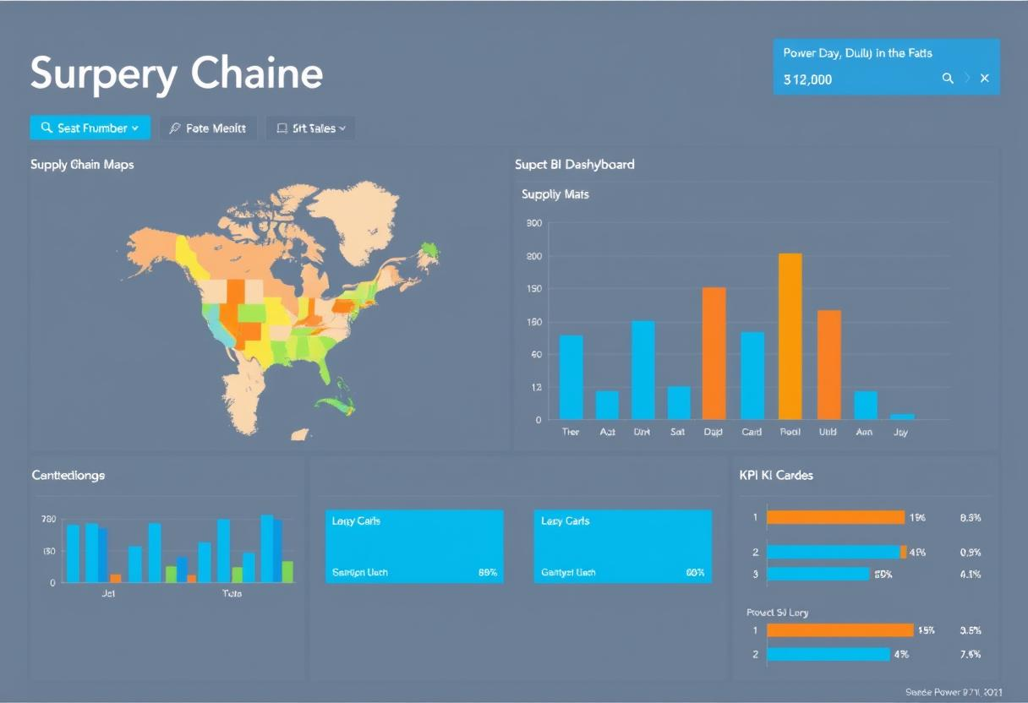
Dashboards and Visualizations in Power BI
Overview
Revenue, and top products metrics visualized.
Supplier Analysis
Defect rates and lead time insights for supplier evaluation.
Inventory Management
Stock versus demand highlights overstocking issues.
Customer Analysis
Sales by gender and buying behavior trends.
Shipping Analysis
Transportations and shipping costs by Routes and modes.

Slide 8
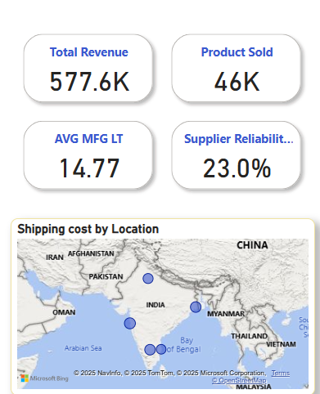
1- Overview
Suppliers: 4 analyzed | Supplier 1: Highest revenue, 48.1% reliability | Supplier 4: 0% reliability
Top Category: Skincare – 24,366 units, 2.33 defect rate, fastest stock turnover
Worst Category: Haircare – 2.48 defect rate, 17.07 days avg. lead time
Inventory: 5,000 total units | Cosmetics = slowest turnover | Skincare = understocked but fastest-moving
Customer Segment Leader: “Prefer not to say” – $173.09K revenue, 15,211 units sold
Shipping: Avg. time = 5.75 days | Total cost = $554.82K | Costliest route = Route A

Slide 9
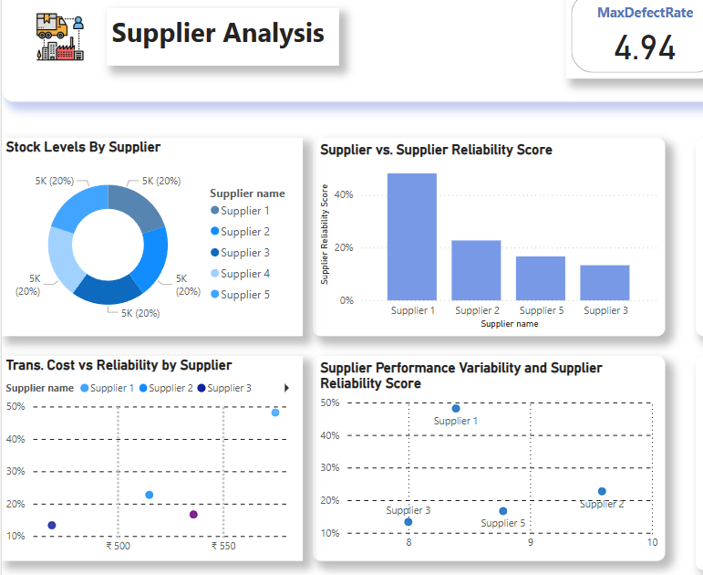
2- Supplier Analysis
Total Suppliers: 4
Top Performer: Supplier 1 – Highest sales, 48.1% reliability
Worst: Supplier 4 – 0% reliability, 100% inspection failure
Issues: Supplier 2 & 3 – Long lead times, high variability
Transport Cost Hotspot: Route A = consistently highest cost

Slide 10
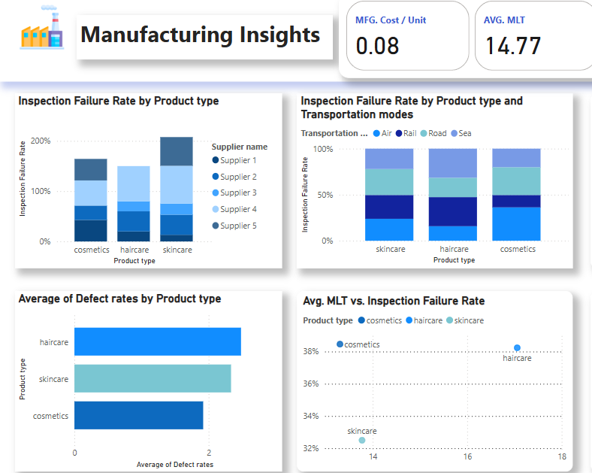
3- Manufacturing Insights
Top Volume: Skincare – 24,366 units, 2.33 defect rate, 13.78 days MLT
Worst Quality: Haircare – 2.48 defect rate, 17.07 days MLT
Best Performer: Cosmetics – Lowest defect rate (1.92), shortest MLT (13.31 days)
Common Issue: High inspection failure across all categories

Slide 11
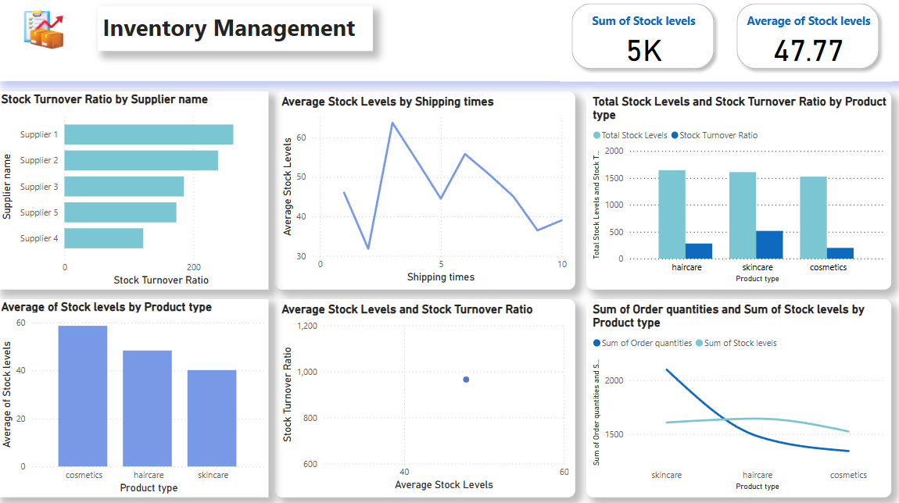
4- Inventory Managment
Total Stock: 5,000 units
Fastest Turnover: Skincare – high demand, understocked
Slowest Turnover: Cosmetics – likely overstocked
Supplier Insight: Supplier 1 = most efficient turnover, Supplier 4 = worst
Inventory Mismatch: Align reorder levels with turnover trends

Slide 12
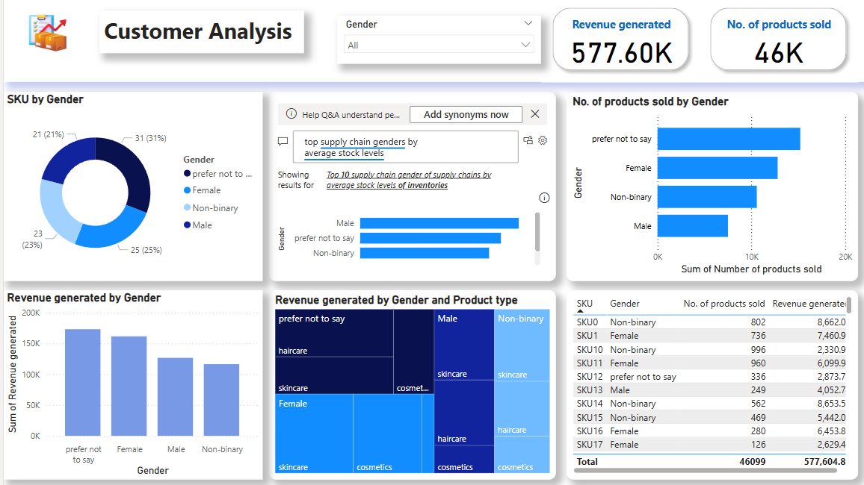
5- Customer Analysis
Top Segment: “Prefer not to say” Revenue: $173.09K, Units: 15,211
Next Best: Female customers – $161.51K, 12,801 units
Product Preference: Skincare leads overall | Haircare most popular with top segment
Key Insight: High-value segment lacks targeted marketing

Slide 13
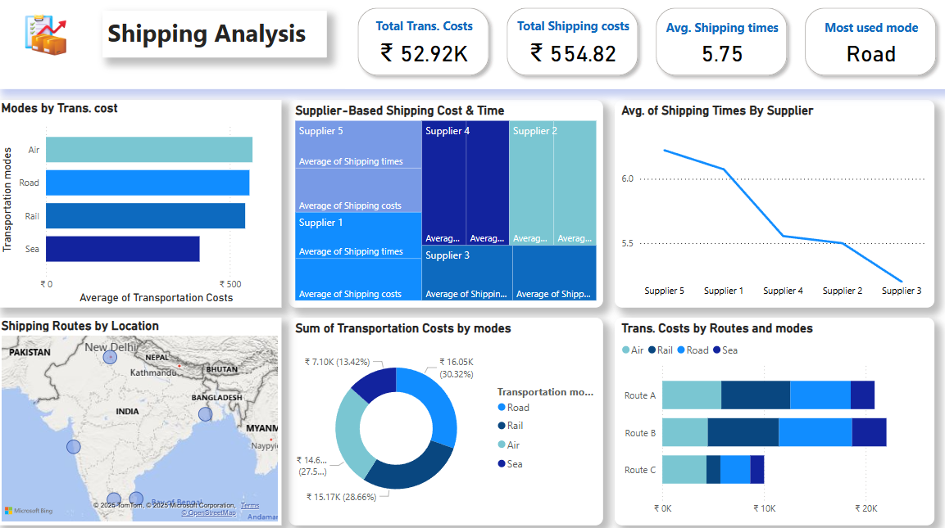
6- Shipping Analysis
Total Shipping Cost: $554.82K
Avg. Shipping Time: 5.75 days
Most Used Mode: Road – also highest total cost ($16.05K)
Fastest Location: Bangalore (5.28 days)
Slowest: Chennai (6 days)
Costly Route: Route A – optimize or reroute

Slide 14

Insights and Recommendations
1. Supplier Performance
•Insight: Supplier 4 is unreliable with 0% inspection pass rate; Supplier 1 has high volume but poor reliability.
•Recommendation: Eliminate Supplier 4; renegotiate or monitor Supplier 1 closely; onboard higher-performing suppliers.
2. Manufacturing Quality
•Insight: High defect rates in haircare and skincare; cosmetics have better performance.
•Recommendation: Improve quality control for haircare; shift production to better-performing categories.

Slide 15
Insights and Recommendations
3. Inventory Management
•Insight: Skincare is understocked despite high demand; cosmetics are overstocked.
•Recommendation: Adjust inventory based on turnover; increase skincare stock, reduce cosmetics.
4. Customer Behavior
•Insight: “Prefer not to say” group leads in revenue and volume; current marketing is too gender-targeted.
•Recommendation: Use inclusive, behavior-based segmentation for personalized marketing.
5. Logistics & Shipping
•Insight: Route A and road transport drive high costs; Chennai has slowest delivery.
•Recommendation: Optimize route planning and evaluate alternative shipping modes and partners.

Slide 16

Project Team and Roles
Data Cleaning and Preprocessing: Ritage Hamada & Nada El Sayed.
Data Modeling phase: Ritage Hamada & Nada El Sayed & Mohammed Ayman
Analysis Questions and Calculation phase: Mohammed Ayman.
Dashboard Phase: Youssef Atef & Mohammed youssef Fakhry & Ritage Hamada & Nada El Sayed & Mohammed Ayman .
Final Presentation: Mohammed Ayman

Slide 17

Thank You
We appreciate your time and attention throughout this project.
Looking forward to your feedback and next steps together.
Please reach out with any questions or further insights.

